Slide 1


End to End Automated Regression Testing with Playwright
https://github.com/BMayhew/playwright-demo
Notes:
End to End = Dom to Database!!!!
Regression testing == to give us confidence in our releases.

Slide 2

The 'New Tool On The Block': Playwright!
https://github.com/BMayhew/playwright-demo

Slide 3


HOWDY 👋 I’m
Butch Mayhew
https://github.com/BMayhew/playwright-demo

Slide 4

Automate All the Things

Slide 5
Automate All the RIGHT Things
At the right levels:
Unit/component tests
API regression tests
UI regression tests
Smoke tests
Performance tests
Security tests

Slide 6
Automate All the RIGHT Things
At the right levels:
Unit/component tests
API regression tests (Http to DB)
UI regression tests (Dom to DB)
*Smoke tests
Performance tests
Security tests

Slide 7
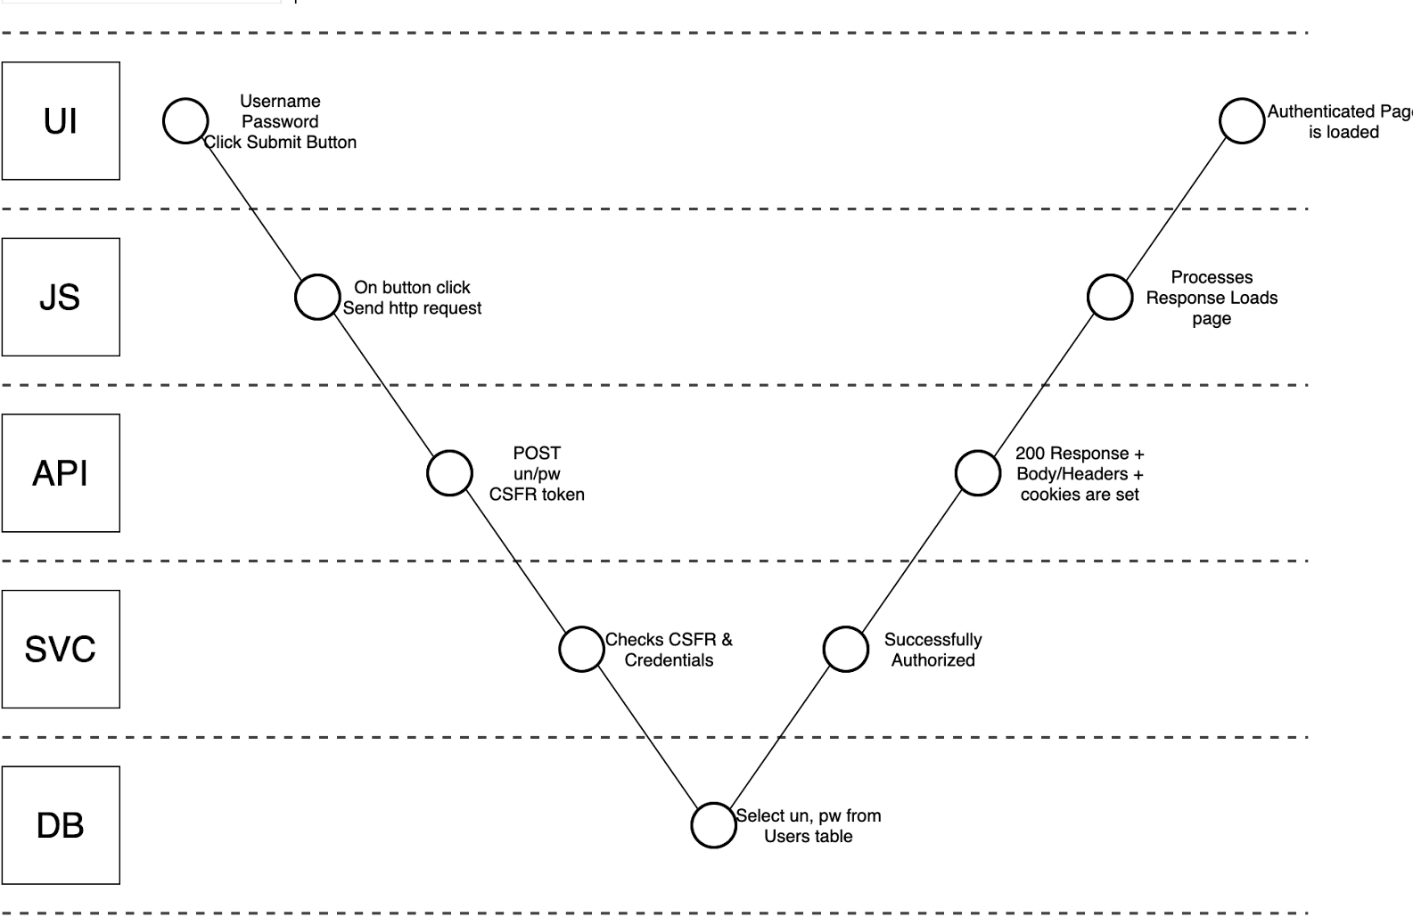
DOM to Database: Visual Task Analysis

Slide 8
Automate All the RIGHT Things
At the right levels:
Unit/component tests
API regression tests
UI regression tests
*Smoke tests
Performance tests
Security tests
You can’t automate away exploratory testing

Slide 9
Automate All the RIGHT Things
At the right levels:
Unit/component tests
API regression tests
UI regression tests
*Smoke tests
Performance tests
Security tests
You can’t automate away exploratory testing
BUT you can automate boring checks (test cases)

Slide 10
Automate All the RIGHT Things
At the right levels:
Unit/component tests
API regression tests
UI regression tests
*Smoke tests
Performance tests
Security tests
You can’t automate away exploratory testing
BUT you can automate boring checks (test cases)
Big fan of using automation in testing – frees me up to apply critical thinking to the system/changes

Slide 11

Agenda
01 What is Playwright?
Overview of Playwright
02 Tilled’s CI/CD Pipeline
Where we leverage Playwright in CI
Overview of GitHub actions file
03 IMO: Top 6 Features
Videos, Retries, Reporters, Workers, VS Code Extension, Developer Docs
04 Overview of a Test
UI - Login spec API – Delete Account
Best Practices

Slide 12

What is Playwright?
Playwright is an opensource tool built by Microsoft that enables reliable end-to-end UI and API testing for modern web apps.
Notes:
Comparable to Selenium web driver, cypress, etc.
DOM (HTML) to Database INTERFACE (API) to Database

Slide 13
What is Playwright?
36K ⭐️’s on GitHub
~Monthly Release Cycle
TypeScript, JavaScript, Python, .NET, Java (Ruby/Go Community)
Closer to Selenium WebDriver than Cypress
An out-of-process automation driver that is not limited by the scope of in-page JavaScript execution.
Test Runner is Built-in

Slide 14
Tilled’s CI/CD Pipeline

Slide 15



Slide 16
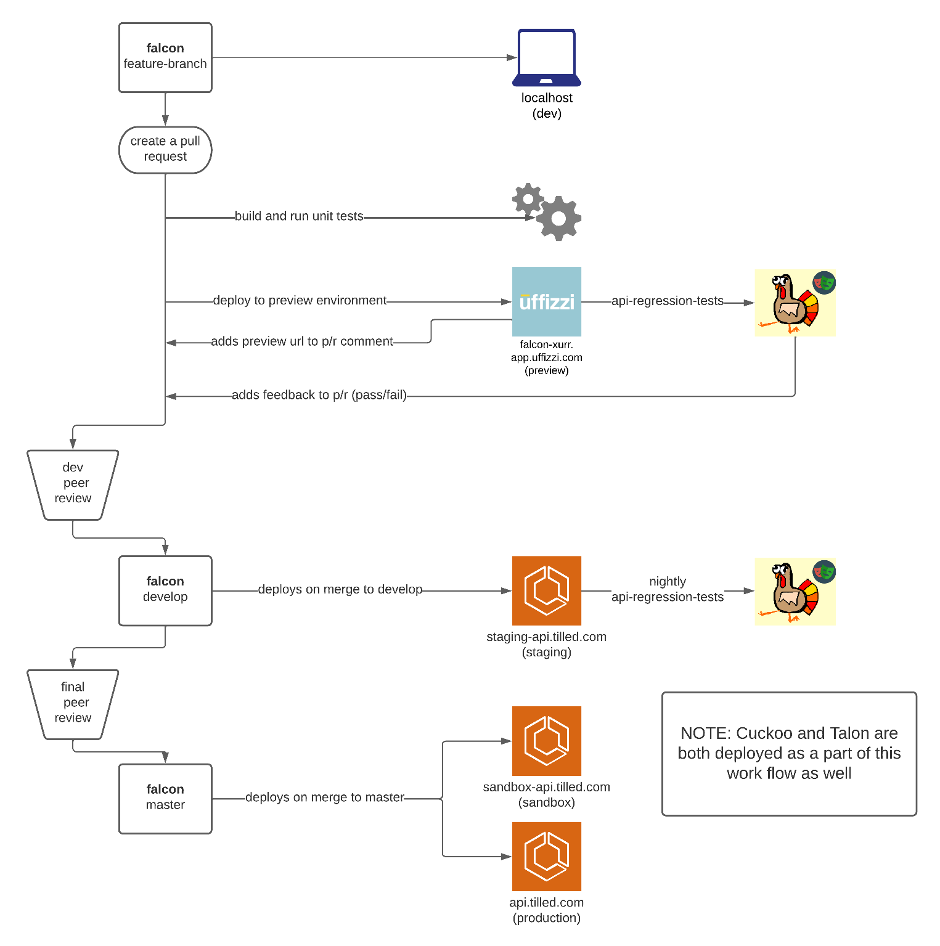


API Service
falcon

Slide 17
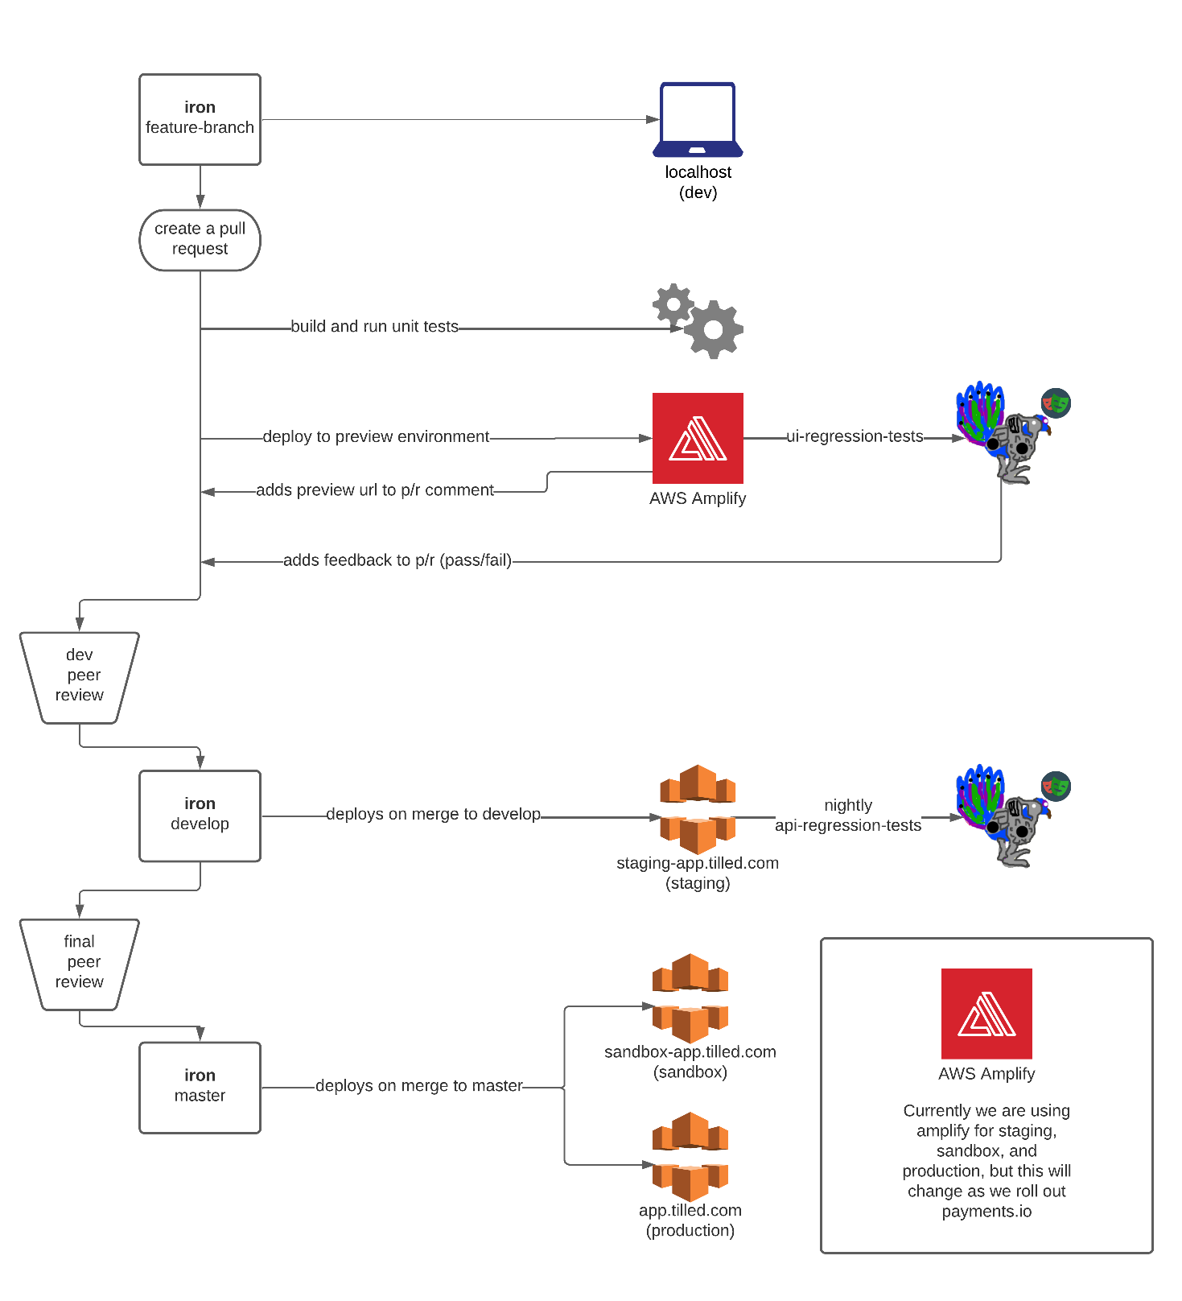
Front End
iron

Slide 18
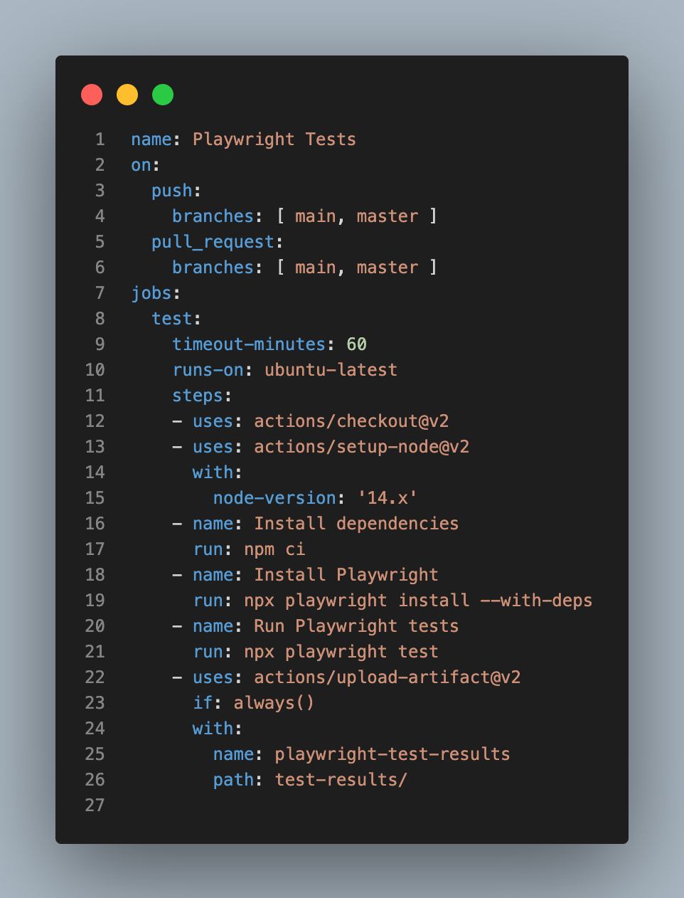
GitHub Actions
yml File

Slide 19
IMO Top 6 Playwright Features as of Today
Reporters
Videos
Retries
Workers (Parallelization)
VSCode Extension
Developer Docs
Ability to Run API/UI Regression
Tests In the Same Framework
Notes:
https://github.com/BMayhew/playwright-demo
https://bmayhew.github.io/playwright-demo/

Slide 20
Overview of a Spec (Playwright Test Runner)
Login – UI
Delete User Account - API

Slide 21
DEMO

Slide 22


Slide 23


Slide 24
DEMO

Slide 25

Automated Tests Best Practices
Write independent automated tests – remove as many dependencies as possible, tests shouldn’t share data between themselves
Setup data/state via API calls
Utilize static data when absolutely necessary (make sure there is an easy way to create static data against any new environments)
Leave state the same way you found it (the framework handles this for us)
Create re-usable methods/functions (page object model)
If #1 is true, we can run all tests in parallel 🏃💨
Goal of suite is catching regressions

Slide 26
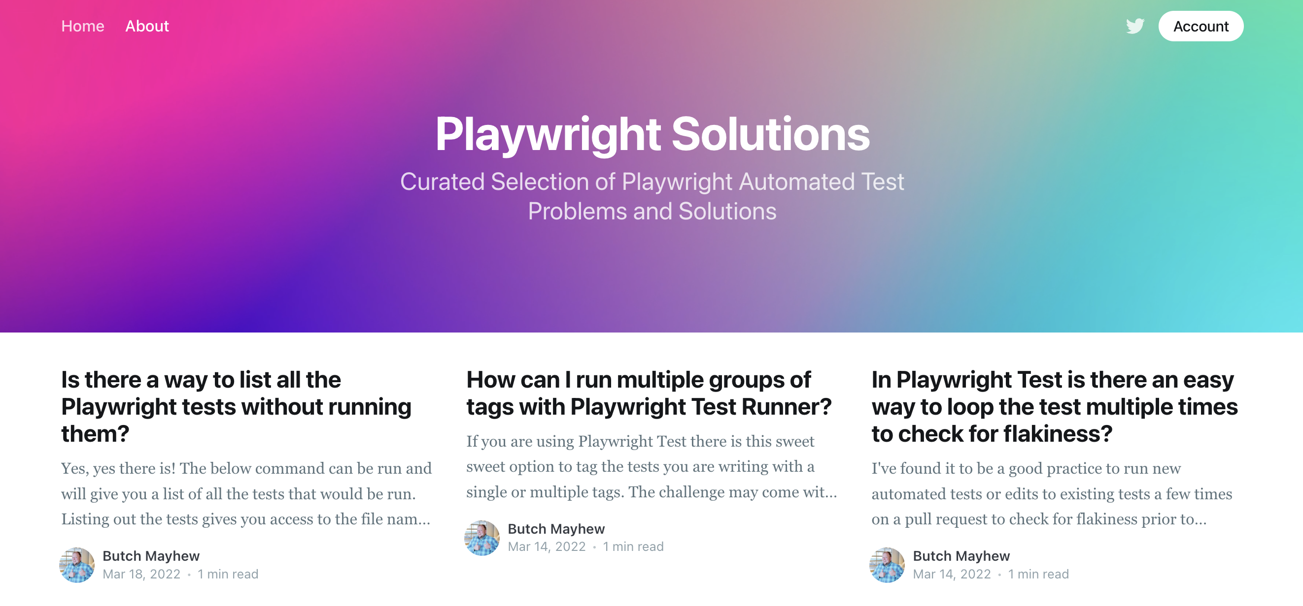
https://playwrightsolutions.com
THANK YOU!
ANY QUESTIONS?

Slide 27

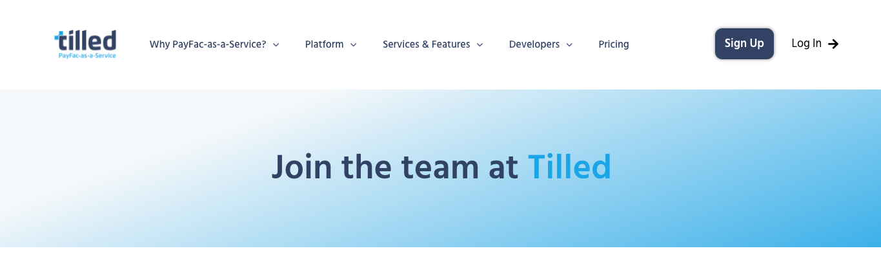
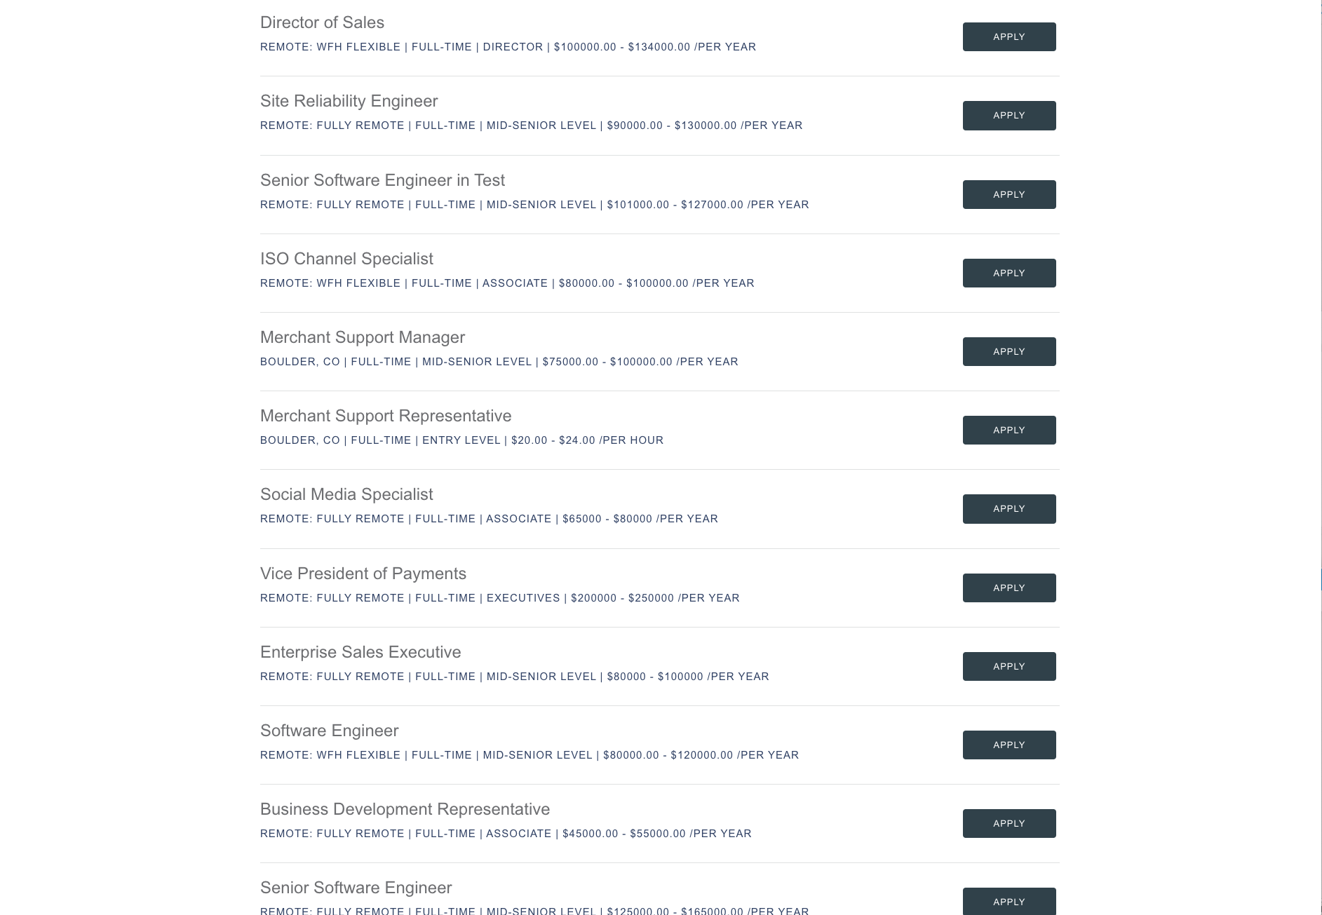
We’re Hiring!
We’d love for you to join our crew.
Get Started: tilled.com/careers

Slide 28
Connect
With Me!
https://github.com/BMayhew/playwright-demo

